Slide 1
Guided Capstone Executive Slide Deck
Jarom Hatch

Slide 2
Problem Identification
Main Issues:
Big Mountain currently charges $81 for adult weekend tickets
Big Mountain not maximizing returns
Which facilities matter most to visitors
Solution:
Create predictive model for ticket price based on number of facilities

Slide 3
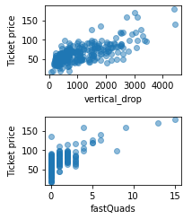
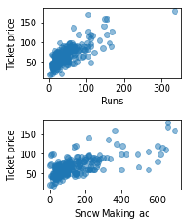
Recommendations and Key Findings
Facilities and amenities versus ticket price
Vertical drop, number of runs, number of fast quad lifts, and snow-making area had positive correlations for further analysis

Slide 4
Modeling Results and Analysis
Modeling conducted three ways:
Based on mean
Linear model
Random Forest model
Mean absolute error used to choose best model
Random forest model had lowest cross-validation mean absolute error
Less variability than other models

Slide 5
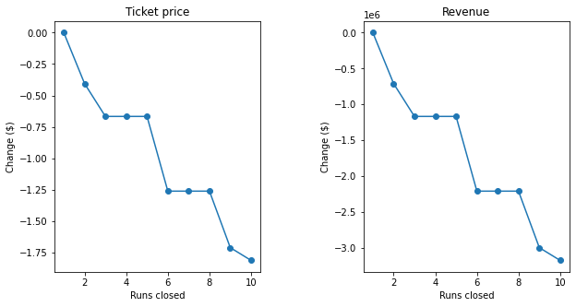
Modeling Results and Analysis

Slide 6
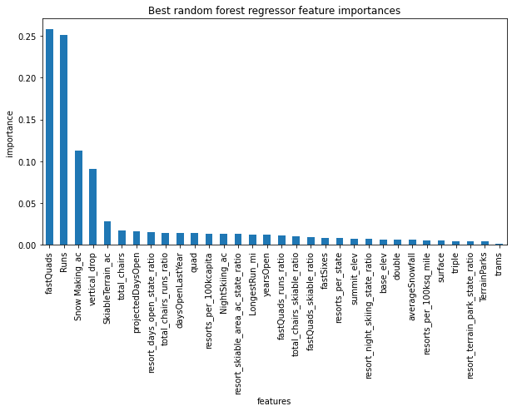
Modeling Results and Analysis

Slide 7
Summary and Conclusion
Ticket price increase by $1.99 if Big Mountain:
Adds one run, increase vertical drop by 150 feet, install additional chair lift or:
Do all of the above and add 2 more acres of snow-making area
Closing one run has no effect on ticket prices
May save operating costs
Closing more may have adverse effect on ticket prices
Provide $3 million in revenue
Enough to pay for additional chair lift

